Slide 1
Shiny And Flex Dashboards
Class 5

Slide 2
Agenda
Homework 2
Shiny Dashboard
Flexdashboard
Publishing to shinyapps.io

Slide 3
Homework 2
Nearly every Shiny application requires you to translate user inputs to allow them to manipulate the data you visualize for them. For this assignment you must use data from an open data website (you may download and clean the data and write it as a CSV). You must also use a different UI layout than what you used in Homework 2.
Directions: Use plotly (with or without the aid of ggplot2) to create three (3) different kinds of figures and one (1) data table. Include at least three (3) types of
Reminder Input Types are:
Numeric
Text
Other/miscellaneous

Slide 4
Shiny Dashboard

Slide 5
Basic Layout
Dashboards are broken into a single argument made up of three arguments
Header – Window title as well as Menus
Sidebar – Sidebar for navigating Dashboard tabs and can hold global selection inputs
Body – Where the magic happens.

Slide 6
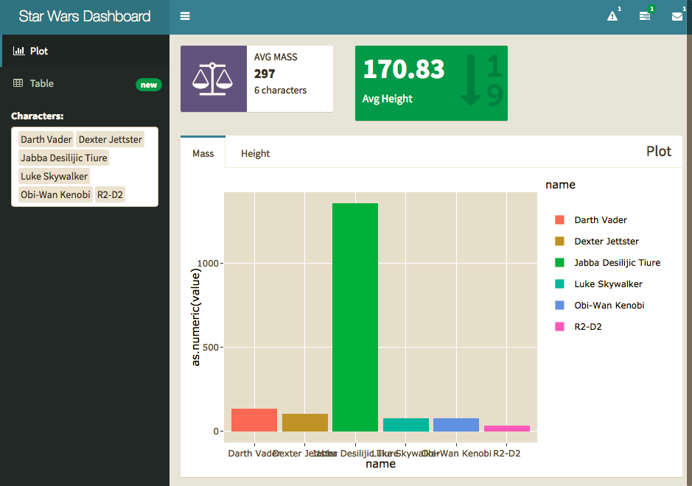

Slide 7
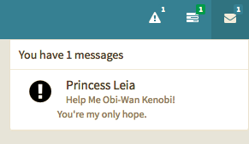
Headers

Slide 8
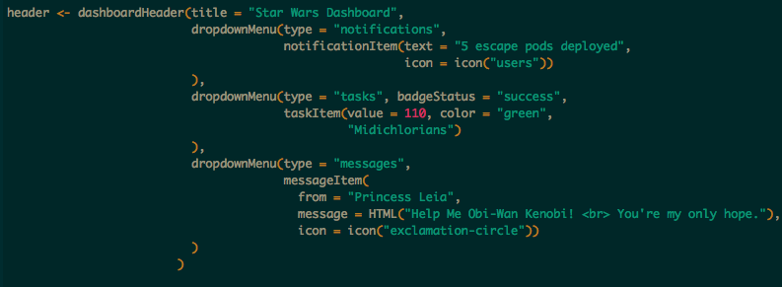

Options
Notifications
Tasks
Messages

Slide 9
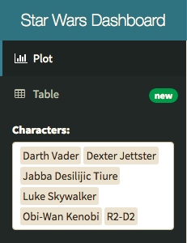
Sidebar

Slide 10
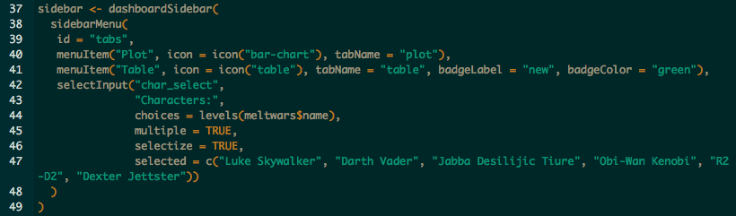
Menu Items – tabName referenced in body.
Global Inputs – Should work on all tabs and for all visuals.

Slide 11
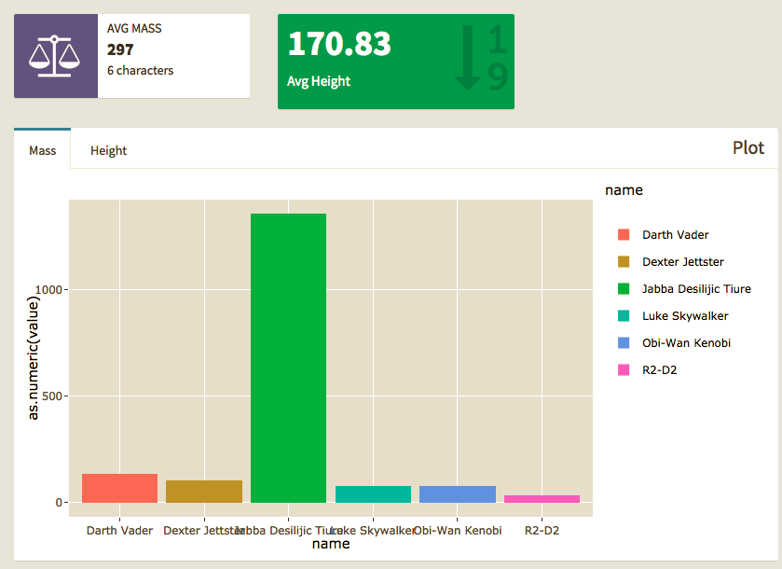
Body

Slide 12
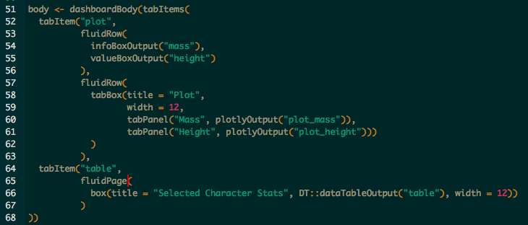
Tab Items – by name in Menu
Row\Page – based layouts
Box – All contents should go in a box
Page is broken into 12 equal bars. Width can be 1-12
If 12+ is specified content will kick to new row automatically, anything unspecified will get squished.
Inputs – can also go in boxes here should be clear what visuals they work with.

Slide 13
Practice
Storyboard - Blank

Slide 14
Flexdashboard

Slide 15
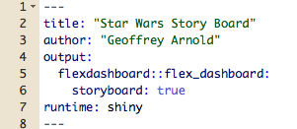
Setup

Slide 16
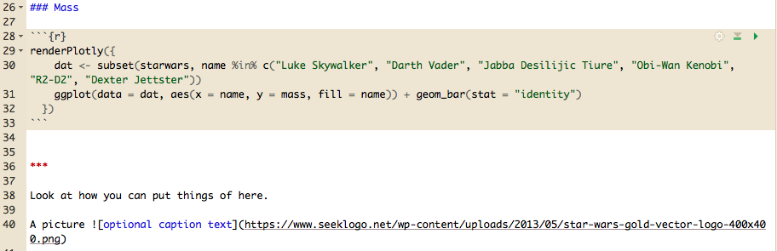
Basic Board Page

Slide 17
Flexdashboard: Storyboard

Slide 18
Setup

Slide 19
Shiny Apps.io
http://www.shinyapps.io/
Section 6

Slide 20
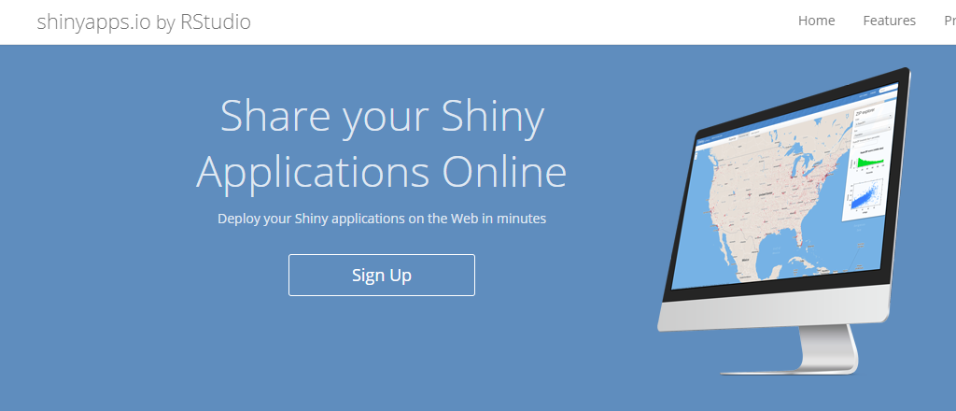
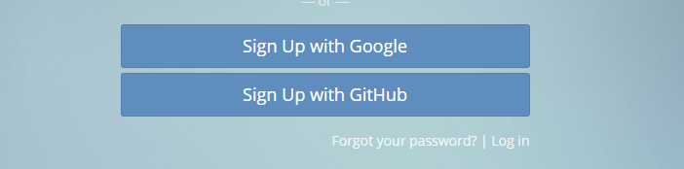
Register a free Account

Slide 21
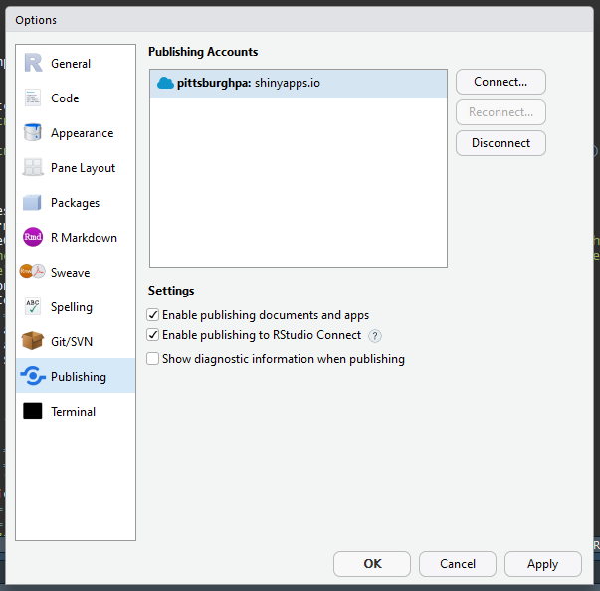
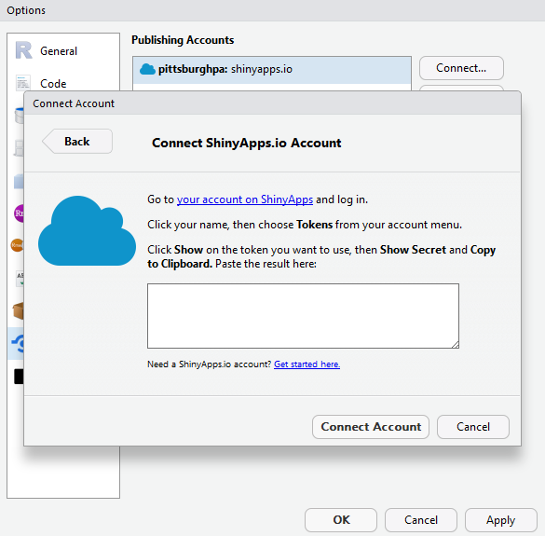
Connect your account

Slide 22

Publish one of todays apps!

